Slide 1
Numerical Analysis (3/7) Ordinary Differential equations
University of Luxembourg - 2024
Master in Mathematics
Hadrien Beriot

Slide 2
Outline
1. Numerical integration
2. Numerical differentiation
3. Summary

Slide 3

1. Numerical Integration

Slide 4
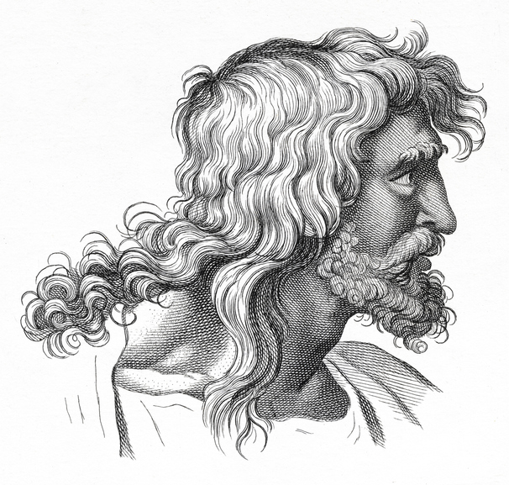
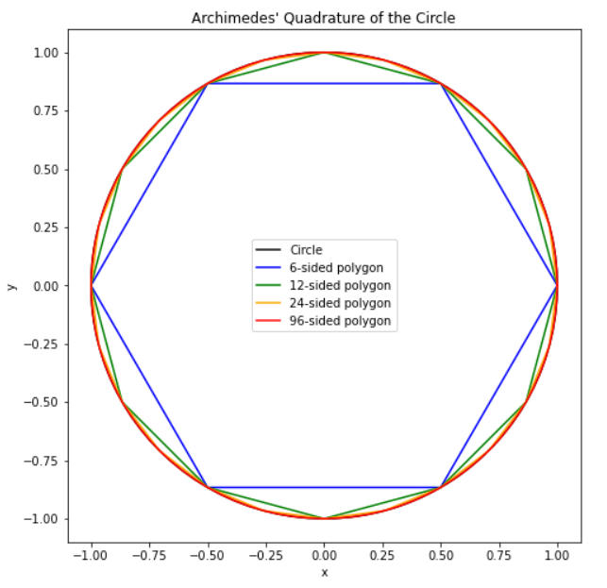

Dates back from Antiquity
In antiquity, aera approximation was know.
Approach was to tile the region with small squares and then count the number of squares within the region
Archimedes (287–212 BCE) used polygons to approximate the area of a circle.
By calculating the areas of inscribed and circumscribed polygons, he found an early approximation for $π$
He obtained by using 96 polygons
$$3.1408 < π <3.1429$$
Notes:
3.141592

Slide 5

Numerical integration
Being given a continuous function $f : [a, b] →ℝ$, we try to compute the integral
$$I=\int_{a}^{b}{f\left(x\right) dx}$$
We need to use numerical integration when we do not know the explicit form of the primitives of $f$ :
$$f\left(x\right)=e^{−x^{2}}, f\left(x\right)=\frac{e^{x}}{x}, f\left(x\right)=\frac{1}{log⁡(x)}$$
We do not want to compute exactly the value of this integral but only an approximate value $I_{app}$ with an a priori given accuracy $ε$ i.e. such that
$$|I − I_{app}| < ε$$

Slide 6
3. Summary

Slide 7
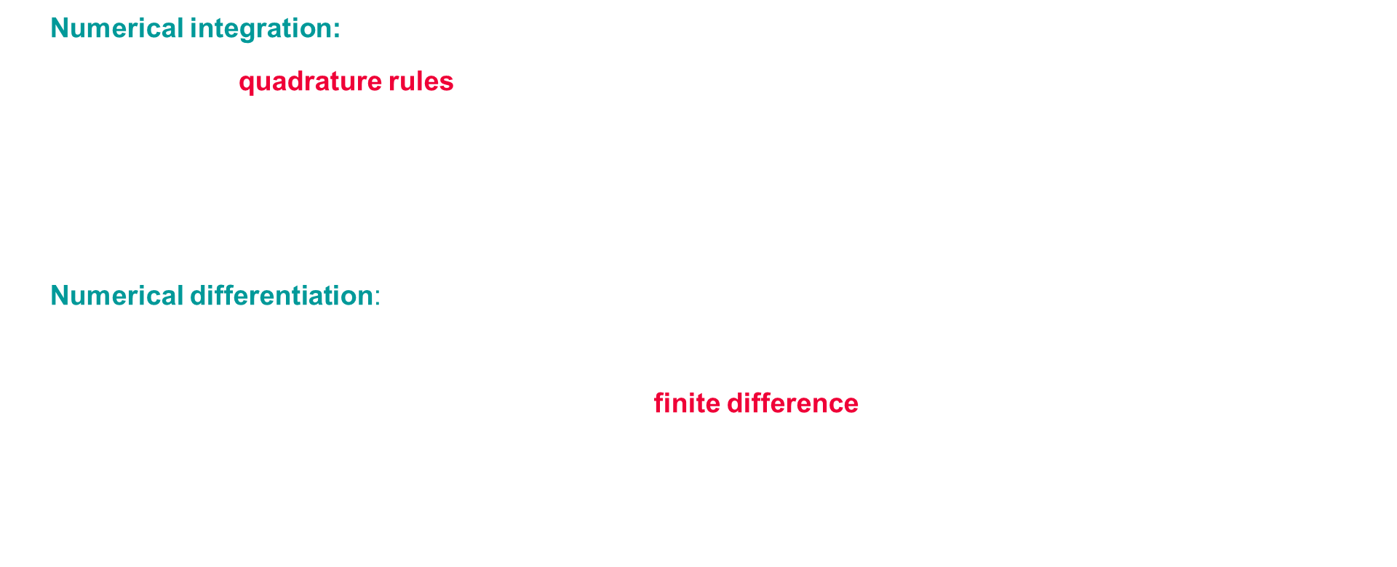
Summary
Numerical integration:
Elementary quadrature rules typically yield $n−1$ order accuracy
Gaussian rules yield $2n−1$ order by optimizing both quadrature weights and points
Dividing original domain (composite rules) possibly with adaptivity is often the best choice
For high-dimensional domains, Monte Carlo integration is the method of choice
Numerical differentiation:
Highly sensitive to noise in the data (by contrast to integration)
For smooth known or implicit functions (PDE), finite difference formulas are typically used
Obtained from Taylor expansion (forward, backward, centered) or from polynomial interpolation

